Slide 1

Antimicrobial Stewardship Annual Update
Updated January 2024
DNV NIAHO Revision 23-1-IC.3.SR.3d—The leader(s) of the antimicrobial stewardship program is responsible for: competency-based training and education of organization personnel and staff, including medical staff, and, as applicable, personnel providing contracting services, on the practical applications of antibiotic stewardship guidelines, policies, and procedures

Slide 2
Teaching Objectives
Introduce the antimicrobial stewardship program (ASP)
Introduce antibiograms
Review 2023 antibiograms
Describe how to utilize culture and sensitivity reports
Introduce Bio-Fire
Review BCID-2 panel results

Slide 3
Learning Objectives
Understand the purpose of ASP
Locate and utilize the MCH antibiogram
Utilize susceptibility reports to design appropriate antibiotic regimens
Utilize BioFire reports to make early adjustments to antimicrobial therapy

Slide 4
Antimicrobial Stewardship Program (ASP)

Slide 5
Definition
Antimicrobial Stewardship Programs (ASP)
ASP promotes appropriate use of antimicrobials to
Improve infection cure rates
Reduce rates of treatment failure
Decrease incidence of C. diff
Decrease adverse events from medications
Decrease antibiotic resistance
Reduce hospital LOS and cost
Multidisciplinary team with representation from Pharmacy, ID Physician, Microbiology, Infection Prevention, and Nursing staff

Slide 6
DNV
Hospitals must have an antimicrobial stewardship program including the following core elements:
Leadership Commitment: dedicating resources
Accountability: appointing a physician or pharmacist leader
Drug expertise: appointing a pharmacist leader or co-leader
Action: implement interventions to improve antibiotic use
Tracking: monitoring prescribing and resistance patterns
Reporting: regularly reporting antibiotic use and resistance
Education: providing education to medical staff, patients, and families

Slide 7
Effectiveness
Studies have shown that antimicrobial stewardship programs have many benefits including:
↓ hospital length of stay
↓ antibiotic consumption
↓ use of parenteral broad-spectrum antibiotics or hospital-restricted agents
↓ Clostridioides difficile infections
↓ in some multi-drug resistant pathogens
Carling P, Fung T, Killion A, Terrin N, and Barza M. Infection Control and Hospital Epidemiology. 2003;24(9): 699-706
Karanika, S. Paudel, S. Grigoras, C. Antimicrobial agents and chemotherapy. Aug 2016; 60 (8): 4840-4852

Slide 8
Members
Multidisciplinary core team members recommended:
Infectious Diseases physician(s)
Clinical pharmacists/pharmacy specialists
Clinical microbiologists
Information technology specialist
Infection control professionals
Hospital epidemiologists
Also requires support of hospital administration, medical staff leadership, and local providers

Slide 9
Policies
Policy MCH-2112
Committed to establishing policies and procedures that meet DNV standards
MCH program supported by administration and the members include:
Infectious disease physicians: Dr. Pablo Feuillet and Dr. Eduardo Morfa
Pharmacy dept: Alex Rothenberger, Pharm.D.
Microbiology: Joselito Laguesma
Infection Prevention: Brenda Dalrymple
Pharmacists, laboratory personnel, nurses, physicians, and infection control staff

Slide 10
Policies
Infectious Disease Rounds (Policy MCH-2112)
Patients meeting criteria presented to ID physicians by pharmacists on Tuesdays, Wednesdays, and Thursdays
Criteria for presentation: Broad spectrum antibiotics >72 hours, any antibiotics >7 days, high-cost antibiotics, and non-formulary antibiotics
After discussion with ID physician, if there are any recommendations, the appropriate physician will be contacted, and a note will be written in the electronic medical record
These interventions are tracked as accepted/declined by antimicrobial stewardship program

Slide 11
MCH Antibiogram

Slide 12
Antibiogram Methodology
Includes only species with at least 30 isolates tested
Includes the first isolate per patient in the period analyzed, irrespective of the body site from which the specimen was obtained
Results include all drugs from the microbiology report, even those that may not be part of the standard panel
Results for drugs not on the standard panel may have less than 30 isolates tested and may be inconclusive
Multidrug resistant organisms (VRE, MRSA, etc.) may be reported on a different row
% of susceptible isolates are rounded to the nearest whole number

Slide 13
Antibiogram Location

Slide 14
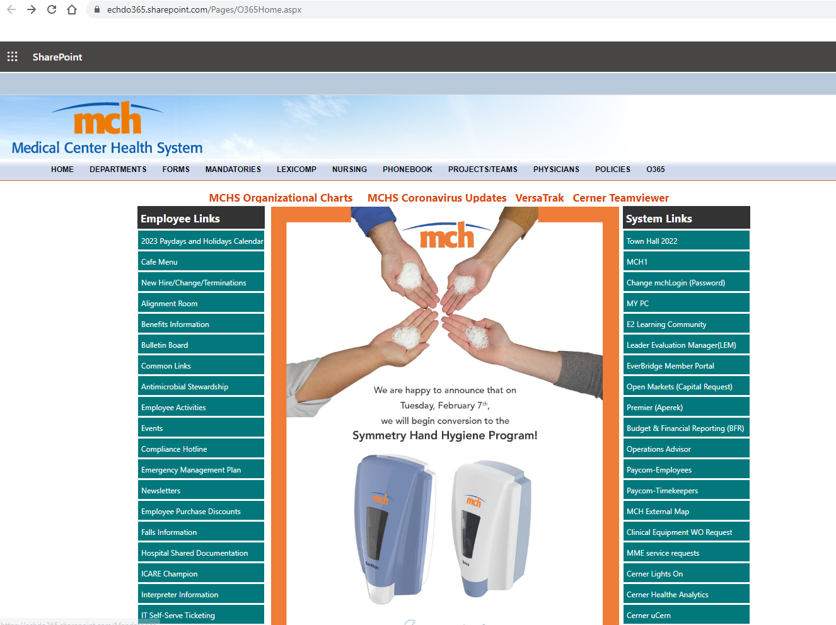

Slide 15
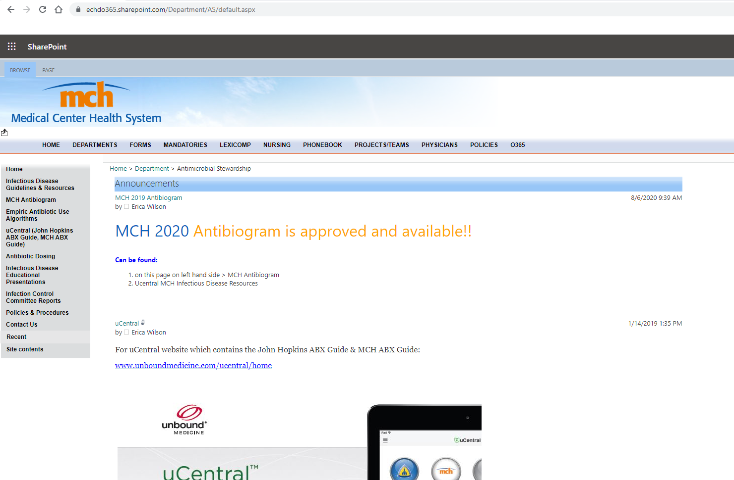
Antibiogram

Slide 16
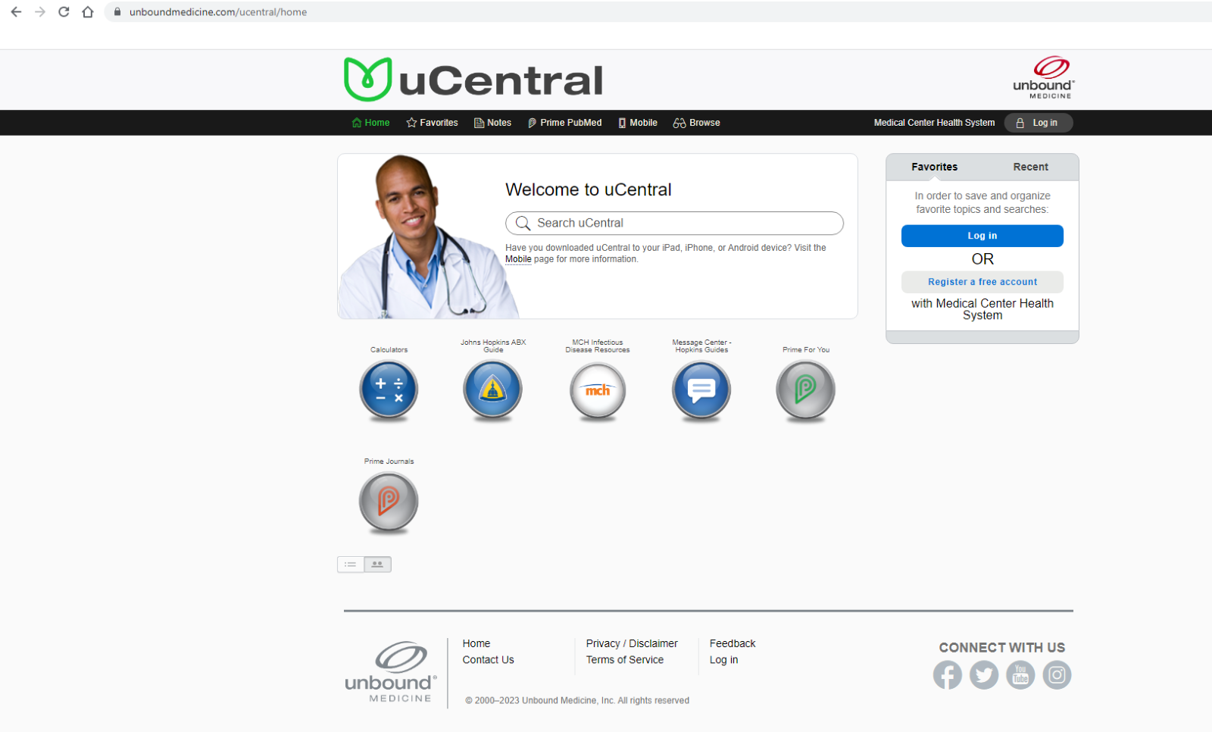
Antibiogram

Slide 17
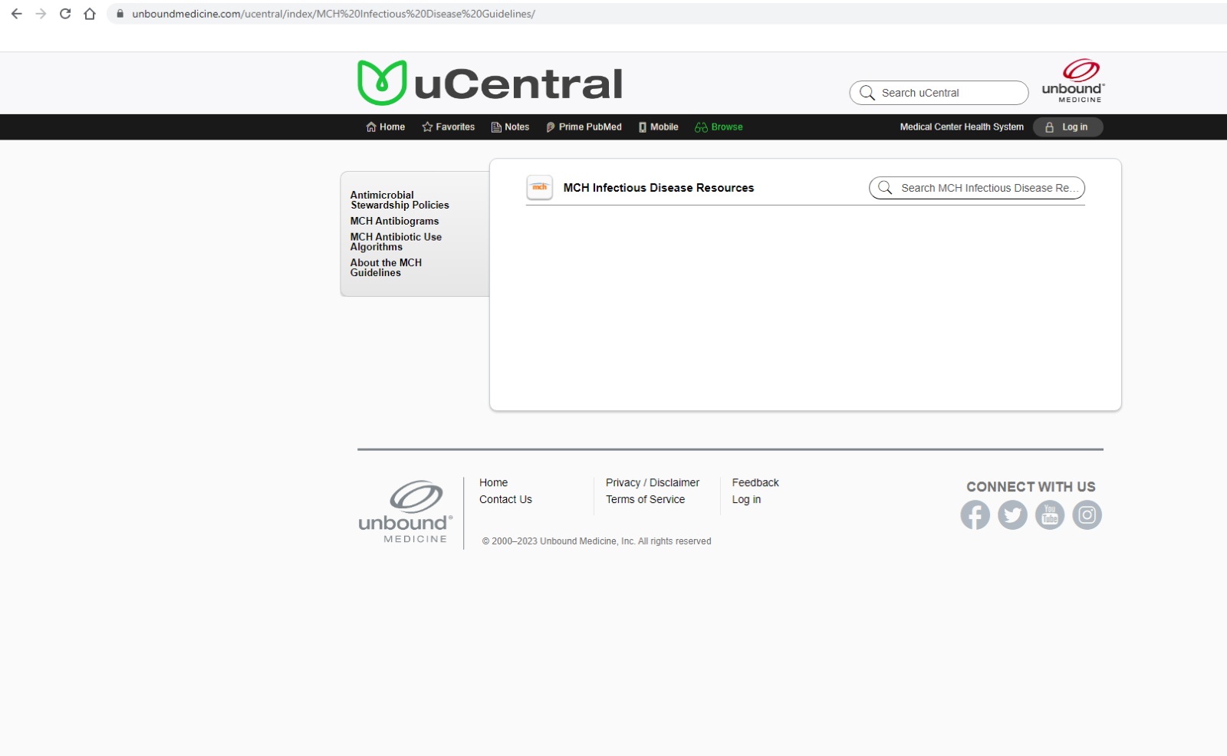
Antibiogram

Slide 18
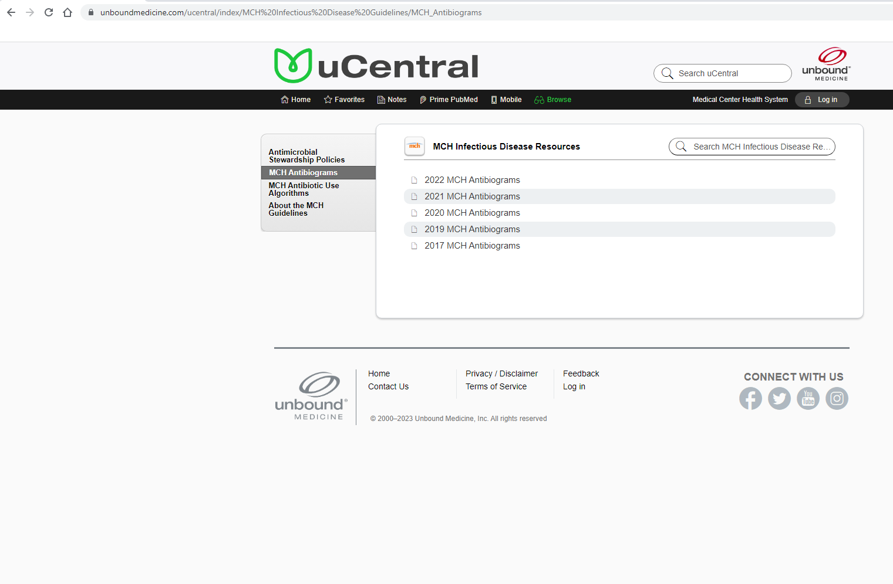

Slide 19
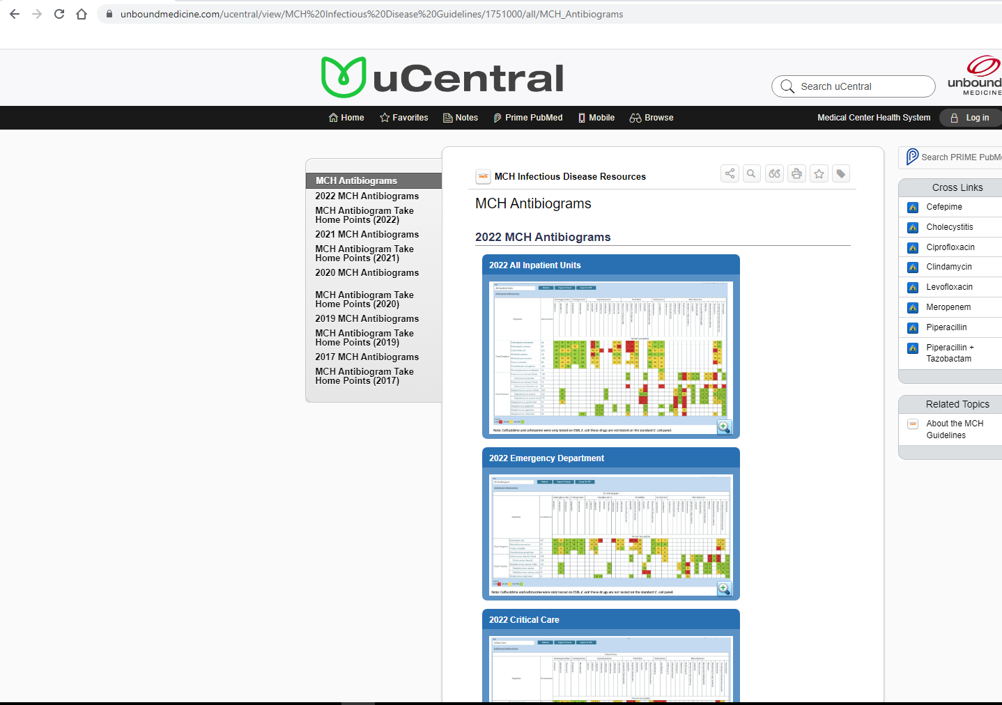

Slide 20
2023 Antibiograms

Slide 21
How to use
Useful data on % susceptibility of formulary antibiotics to common bacterial pathogens
Data may be helpful when choosing appropriate empiric therapy depending on most likely pathogen(s) for suspected infection
90-100% susceptible -- preferred for empiric therapy
80-89% susceptible -- may need double coverage if serious infection
< /= 79% susceptible -- avoid in empiric therapy

Slide 22
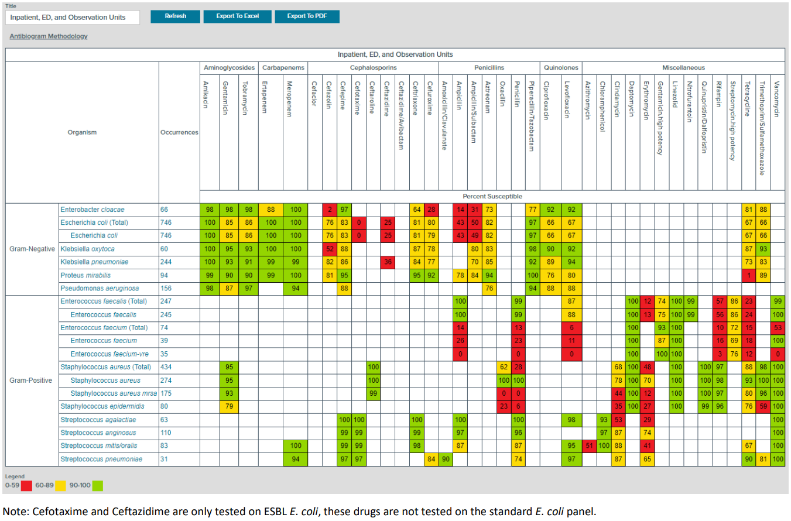

Slide 23
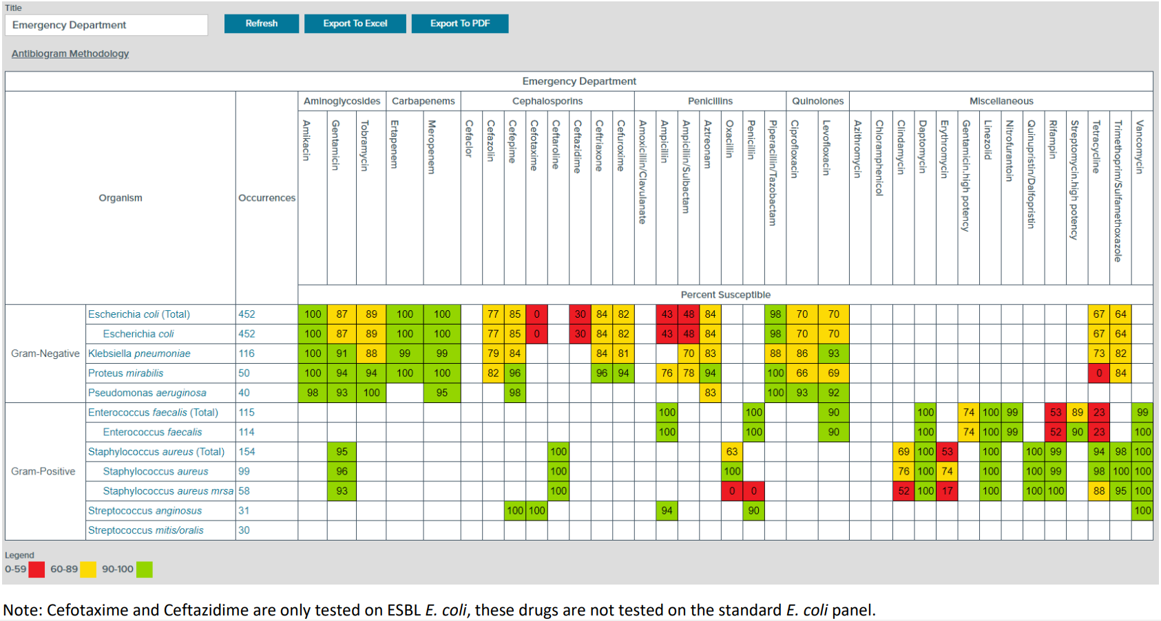

Slide 24
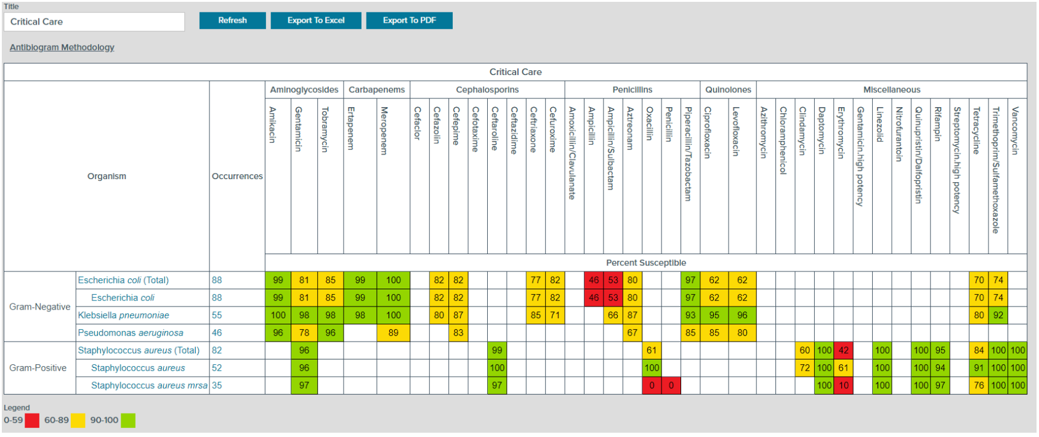

Slide 25
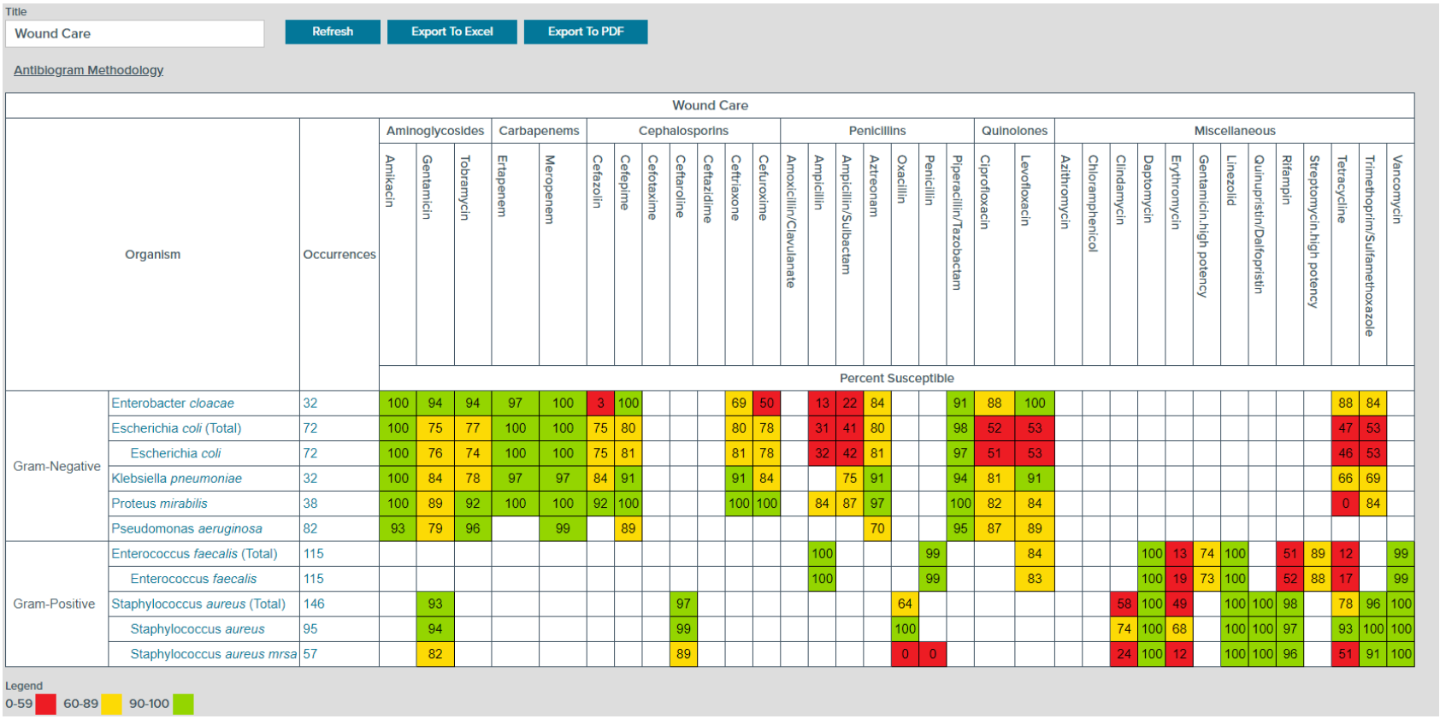

Slide 26
How to read a culture and sensitivity report

Slide 27
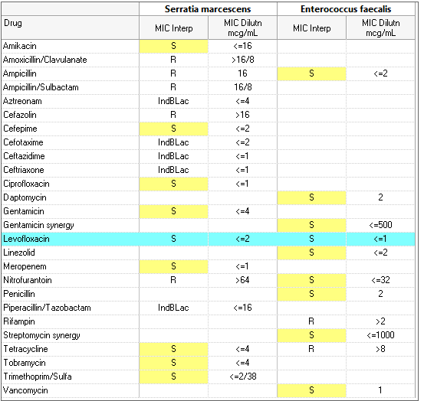
Susceptibility reports
S = susceptible
I = intermediate
R = resistant
IndBLac = Inducible Beta lactamase
Potential for AmpC gene activation
Blue bar = antibiotic that tested S to all isolates
However, it is not always the best antibiotic choice
Often gentamycin is highlighted when staph spp. and gram negatives are isolated together
Gentamycin for gram positive organisms should only be used as synergy for select disease states.

Slide 28
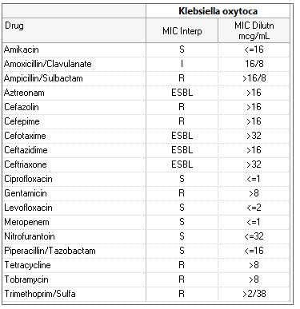
Susceptibility reports
This report demonstrates an extended spectrum beta lactamase (ESBL) producing organism
In this instance the antibiotic of choice could be any sensitive (S) agent
Choice of agent is dependent on patient factors and site of infection
Ex: in uncomplicated cystitis nitrofurantoin, single dose amikacin, or Pip/Tazo could be the best choice.
MIC's between two different drugs cannot be compared
Nitrofurantoin is not less effective than ciprofloxacin when used for an appropriate patient and infection site.

Slide 29
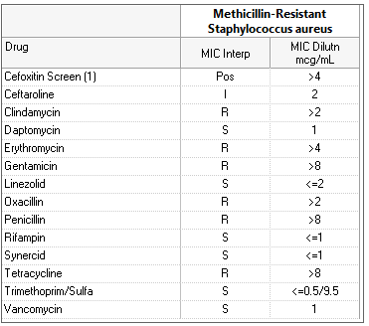
Susceptibility reports
In this instance the narrowest spectrum and guideline directed medical therapy (GDMT) recommended treatment would be vancomycin in a complex bacteremia.
However, GDMT for a simple SSTI would be Bactrim.

Slide 30
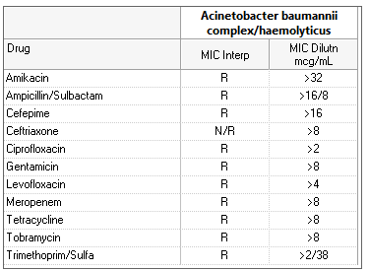
Susceptibility reports
In instances of multi-drug resistant organisms such as this one, an infectious disease specialist consult is strongly recommended.

Slide 31
BioFire

Slide 32
Understanding BioFire
BioFire is a rapid diagnostic test that uses polymerase chain reaction (PCR) to identify genetic material from bacteria or viruses present in certain samples.
BioFire is available for
Blood (BCID2)
Cerebrospinal fluid (Meningitis/encephalitis)
Gastrointestinal
Joint infection
Respiratory (viral + Chlamydia and Mycoplasma pneumoniae)
Pneumonia (18 bacterial targets + 8 viral) - tracheal aspirate and BAL only

Slide 33
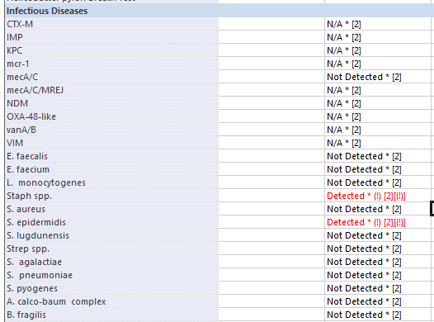
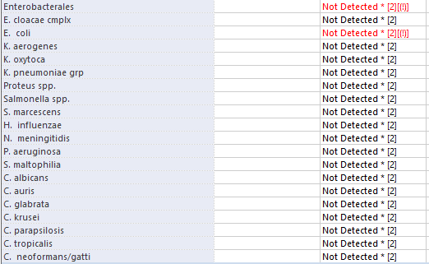
BioFire BCID2
Positive blood cultures with compatible Gram stain are reflexively run through BioFire
If "Not Detected" is red, there is a positive result, but it must be clicked on to see result.
Resistance genes are only tested when an appropriate organism has been detected.
Ex: mecA/C for S. epidermidis

Slide 34
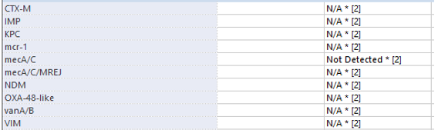
BioFire BCID2 Resistance Marker Tests
Carbapenemases (overall heavy resistance to beta-lactams and carbapenems)
IMP
KPC
OXA-48
NDM
VIM
ID consult strongly recommended

Slide 35
BioFire BCID2 Resistance Marker Tests
Colistin resistance
Mcr-1
Possible ESBL production
CTX-M
Methicillin resistance
MecA/C
MecA/C and MREJ (MRSA)
Vancomycin resistance for enterococcus (VRE)
VanA/B
Disclaimer
These are not the only mechanisms of resistance
A given bacteria may still be resistant even when these tests result with "Not Detected"

Slide 36
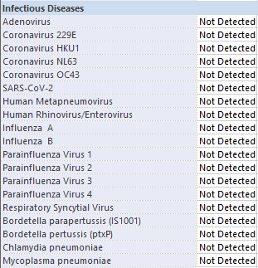
BioFire Respiratory and Pneumonia Panels
Respiratory-EZ panel
19 targets
Includes Chlamydia p. and Mycoplasma p.

Slide 37
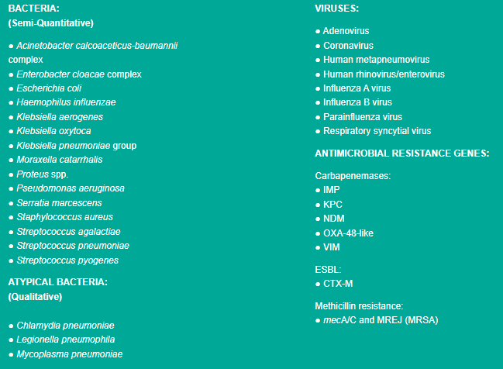
BioFire Pneumonia Panel
Must be ordered separately as "Pneumonia Panel"
Only for tracheal aspirate and BAL samples
33 targets
Provides semi-quantitative results for 15 bacterial targets
Aids determining pathogen vs colonizer

Slide 38
Questions?
Please feel free to reach out to Alex Rothenberger, Pharm.D.
Email: arothenberger@echd.org

Slide 39
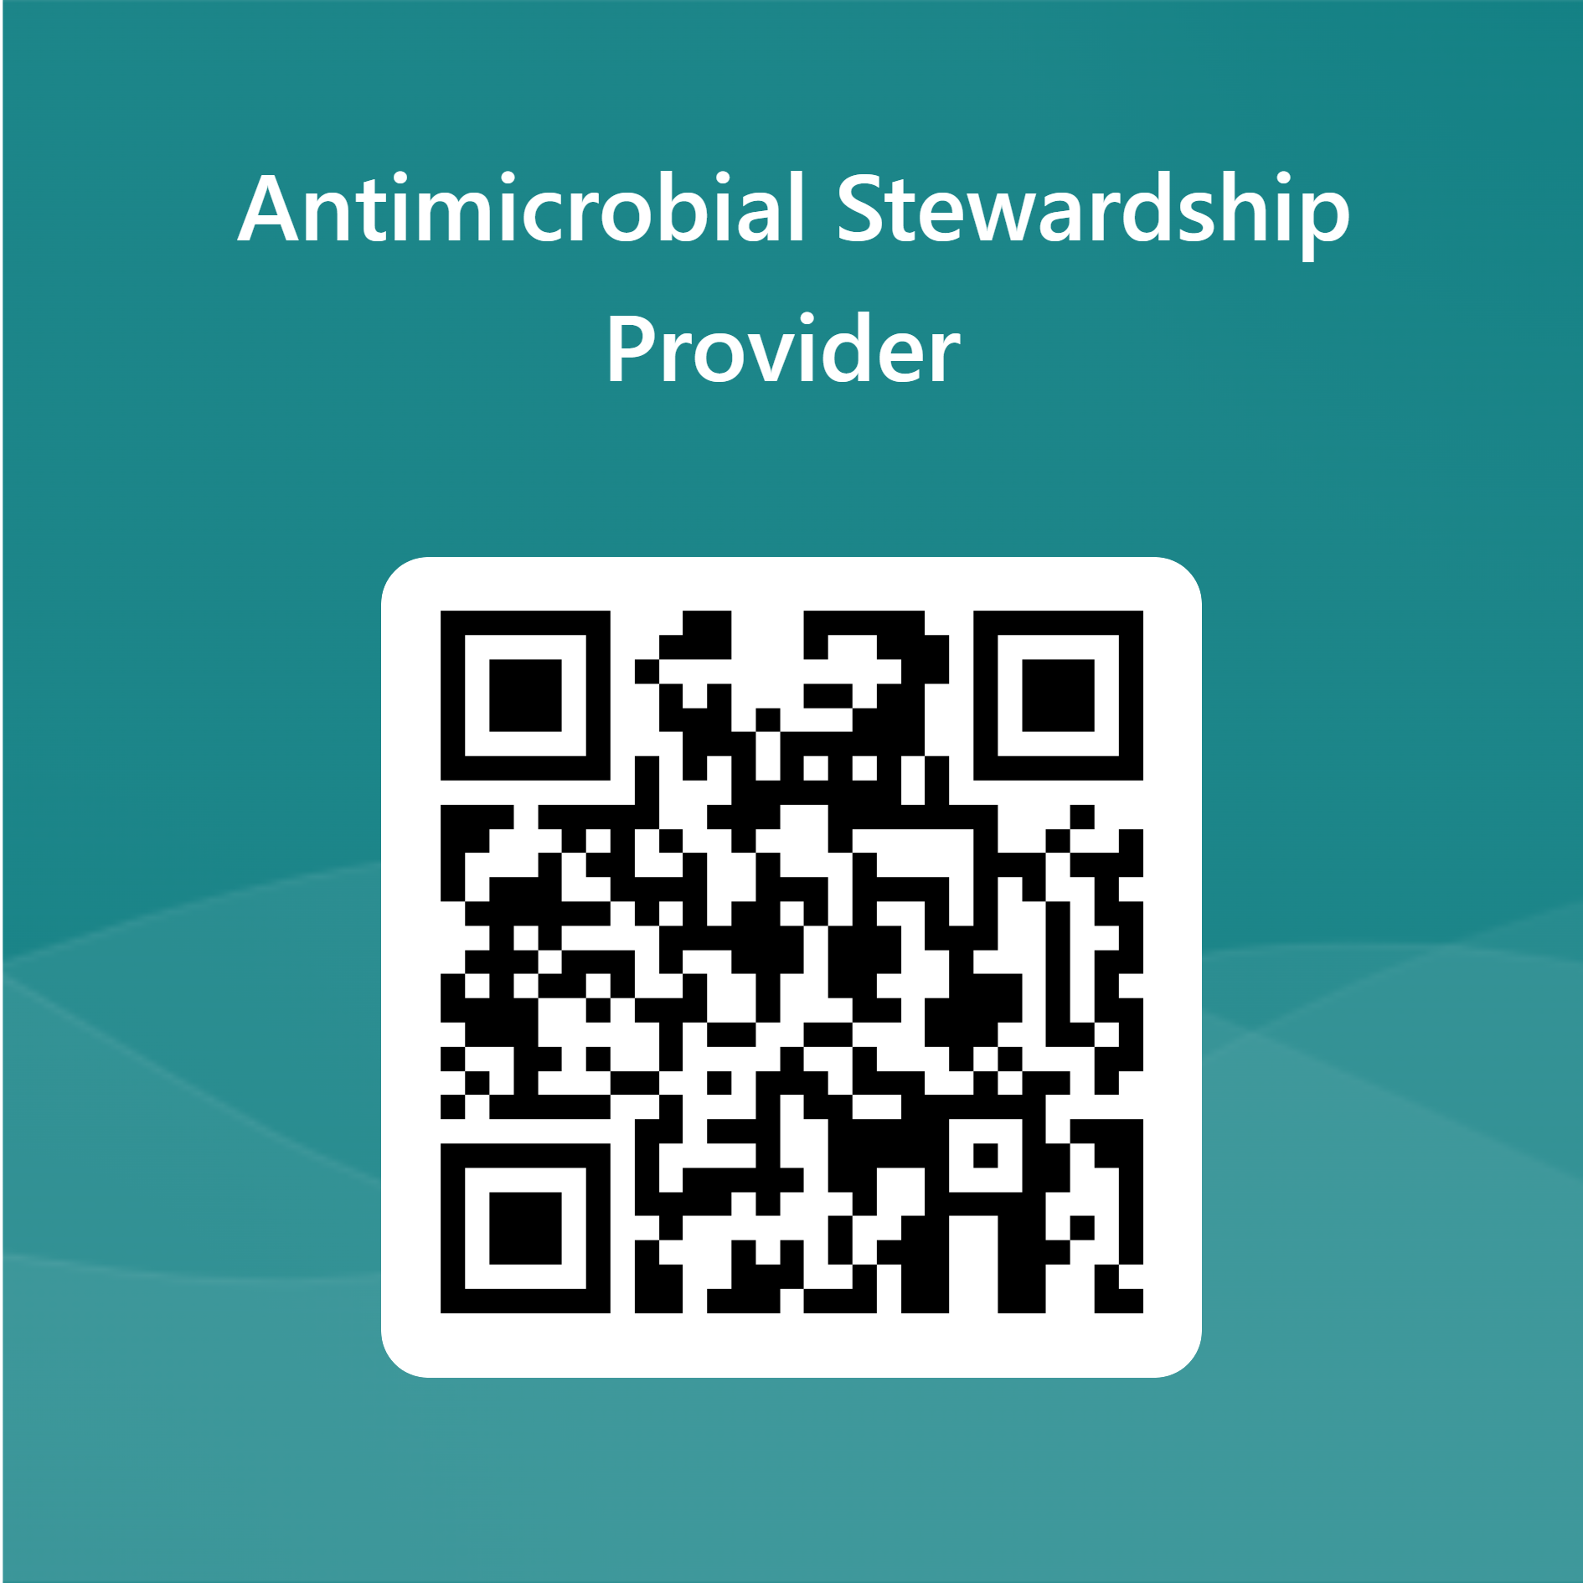
Continue with Test
Link
QR Code
https://forms.office.com/r/RhjviVyeT3

